Slide 1
Addressing High School Dropout in LAUSD
Adriana Ramos

Slide 2
LAUSD: The Broken District
API (Academic Performance)
AYP (Adequate Yearly Progress)
DARC (The District Accountability Report Card)
Dropout
District 20.3%
Los Angeles Unified School District Website
http://notebook.lausd.net/portal/page?_pageid=33,142911&_dad=ptl

Slide 3
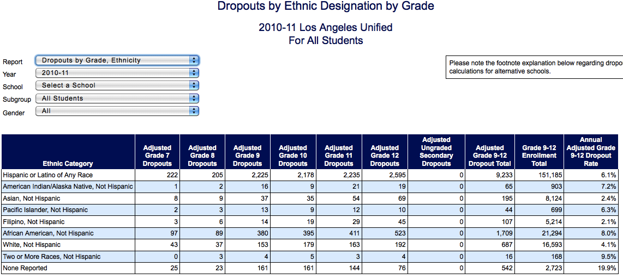
California Department of Education Data Reporting Office
http://dq.cde.ca.gov/dataquest/DropoutReporting/DrpGradeEth.aspx?cDistrictName=LOS%20ANGELES%20UNIFIED&CDSCode=19647330000000&Level=District&TheReport=EthOnly&ProgramName=All&cYear=2010-11&cAggSum=DTotGrade&cGender=B

Slide 4
John C. Fremont High School
2009: 1219 student decline per graduating class (69.2%)
2001: 1806 student decline (79.74%)
Reconstitution (shut down) in December 2009
Reopened a few months later
Located near Downtown Los Angeles
Large school (~5,000)
http://www.westchesterparents.org/downloads/where_have_the_seniors_gone.pdf

Slide 5
Best Practices: Big Picture Learning
Non-profit
Fundamental redesign of standard education
Promote innovative, personalized learning environments
http://www.bigpicture.org/about-us/

Slide 6
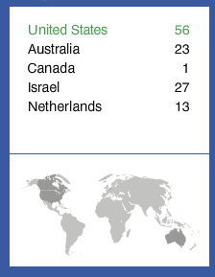
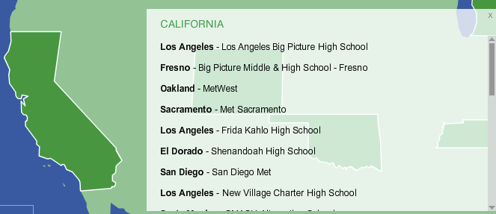
Best Practices: Big Picture Learning
Funded by Bill and Melinda Gates
96% success rate

Slide 7
Policy Proposal
Relationships
Establish peer mentoring
Change the atmosphere of the school community
Relevance
Require volunteer/research class
Rigor
Require completion of college/work-ready course to graduate from high school
Encourage students to fulfill A-G requirements
Support low-performing students

Slide 8
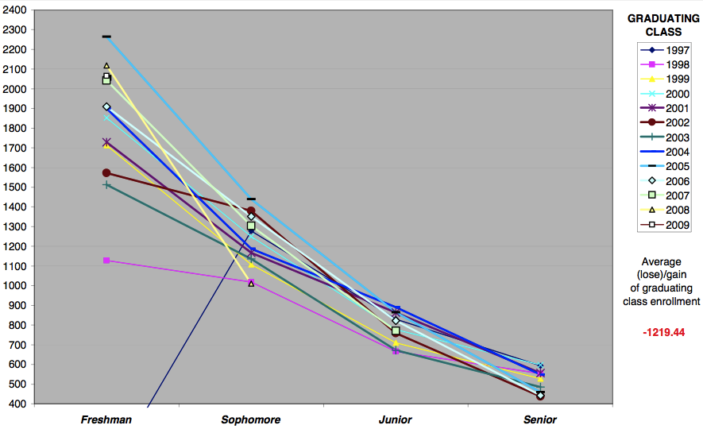
Fremont High Enrollment Tracked by Class

